Slide 1

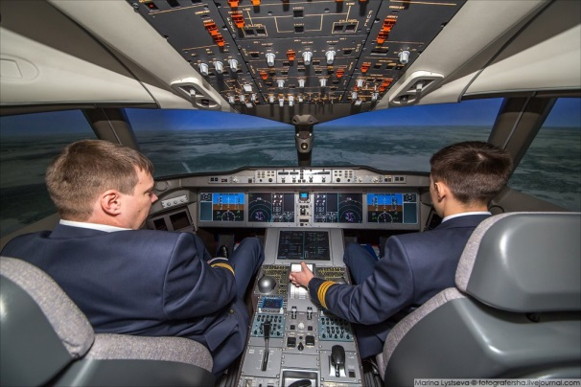

MOSCOW STATE UNIVERSITY OF PSYCHOLOGY AND EDUCATION
Adaptive aircraft crew training based on probabilistic models for estimating the flight crew capability level
L.S. Kuravsky, P.N. Dumin, G.A. Yuryev

Slide 2
Problem statement
Aircraft crew training is one of the most important components of civil and cargo aviation development.
This training is a complex process that is multi-stage and detailed.
Pilots are tested using the full flight simulators designed to ensure maximum compliance with current aircraft control processes.
According to the Evidence-Based Training Implementation Guide, each pilot is required to obtain a set of competencies corresponding to a certain grade specified by the pilot training standards.
These competences are defined as “the combinations of knowledge, skills and attitudes required to complete an assignment at a rescribed grade in accordance with established standards ".
Introduction

Slide 3
Competency | Competency Description | Behavioral indicator
Aircraft Flight Path Management, automation | Controls the aircraft flight path through automation, including appropriate use of flight management system(s) and guidance | Controls the aircraft using automation with accuracy and smoothness as appropriate to the situation. Detects deviations from the desired aircraft trajectory and takes appropriate action. Contains the aircraft within the normal flight envelope. Manages the flight path to achieve optimum operational performance. … Effectively monitors automation, including engagement and automatic mode transitions.
Aircraft Flight Path Management, manual control | Controls the aircraft flight path through manual flight, including appropriate use of flight management system(s) and flight guidance systems. | Controls the aircraft manually with accuracy and smoothness as appropriate to the situation. Detects deviations from the desired aircraft trajectory and takes appropriate action. Contains the aircraft within the normal flight envelope. Controls the aircraft safely using only the relationship between aircraft attitude, speed and thrust. Manages the flight path to achieve optimum operational performance. Maintains the desired flight path during manual flight whilst managing other tasks and distractions…
Situation Awareness | Perceives and comprehends all of the relevant information available and anticipates what could happen that may affect the operation. | Identifies and assesses accurately the state of the aircraft and its systems. Identifies and assesses accurately the aircraft‟s vertical and lateral position, and its anticipated flight path. Identifies and assesses accurately the general environment as it may affect the operation. Keeps track of time and fuel. … Recognizes and effectively responds to indications of reduced situation awareness
etc. | … | …
Examples of competencies given in
the Evidence-Based Training Implementation Guide

Slide 4
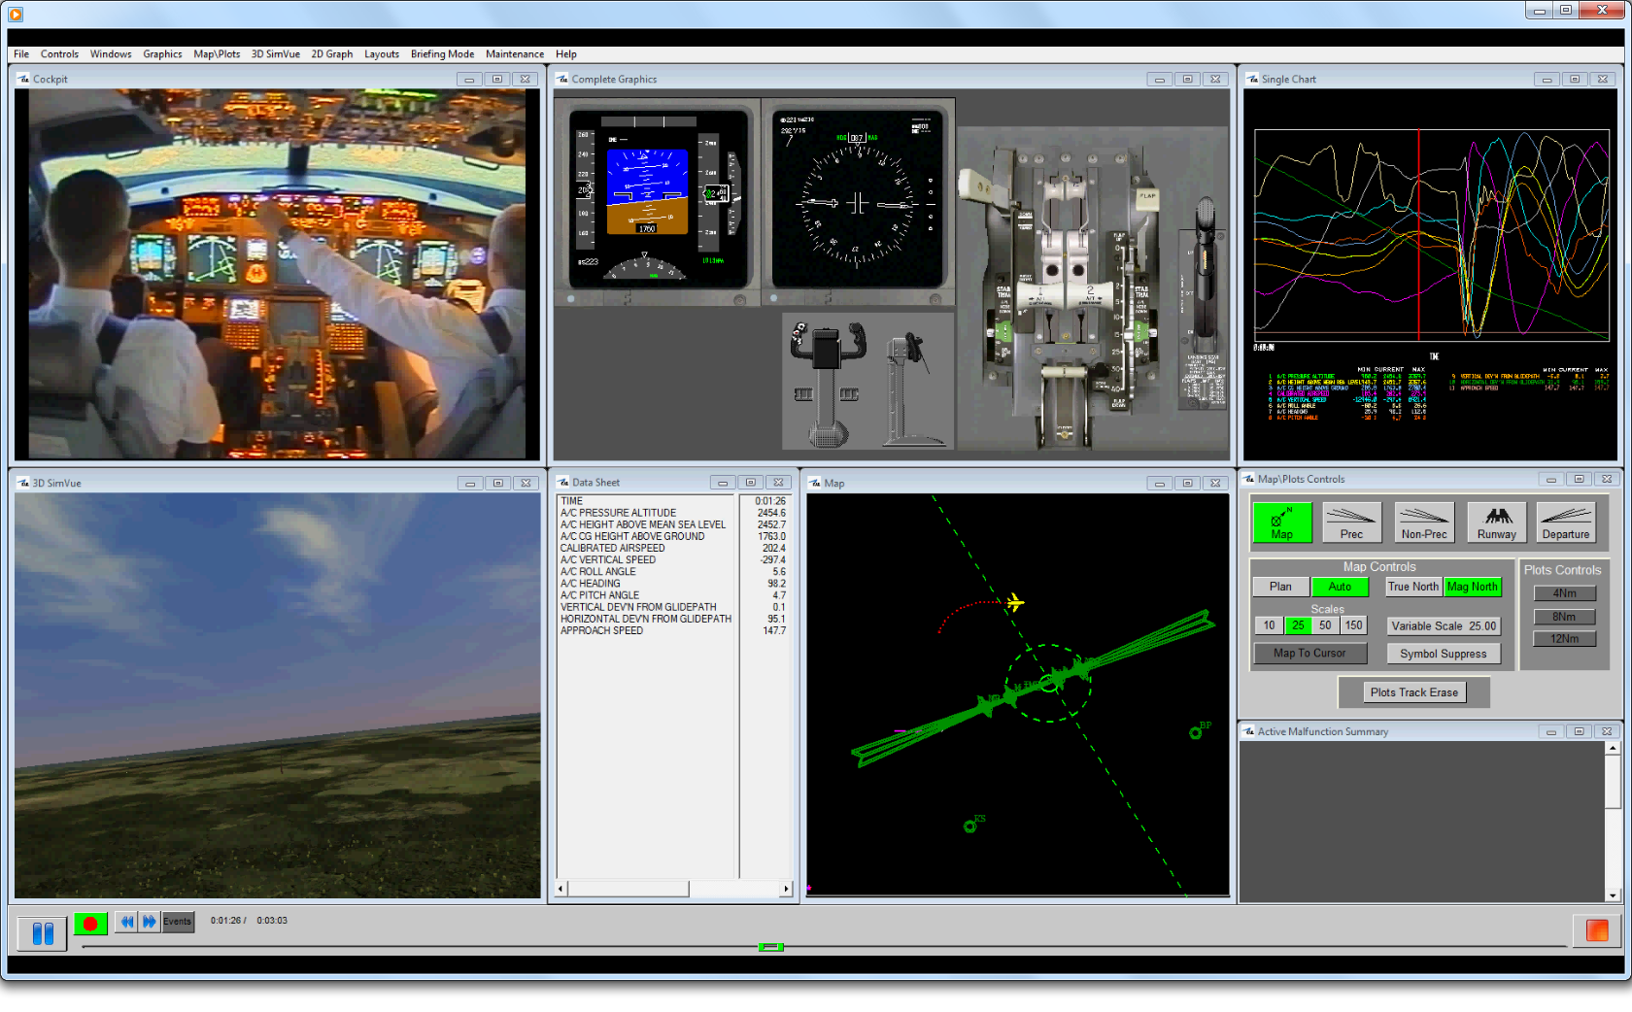
Testing procedure

Slide 5
Testing procedure
Depending on the initial set of competencies, pilots are provided with sets of maneuvers of varying difficulty, in accordance with a relevant set of competencies
Possession of a set of competencies allows the pilot to make quick decisions in emergency situations as well as to implement correctly typical complex tasks
The proposed training concept is described further.
Substantial grades of training process correspond to flight maneuvers of relevant difficulties, which are ordered by the given flight phases and defined by the training manuals
Each maneuver, if it is included at the training schedule under consideration, has to be represented by a training process status
Determined by the implementation of the maneuvers in question are attainment grades
The one-to-one correspondence between attainment and maneuver difficulty grades is assumed.
Problem formalization

Slide 6
Flight phases defined by the training manuals: examples
Flight planning, pre-flight, engine start and taxi-out Taxi-in, engine shut-down, postflight and flight closing;
Take-off;
Climb;
Cruise;
Descent;
Approach;
Landing.
Model in terms of the Evidence-Based Training Guide

Slide 7
Each maneuver has to be represented by a training process status: examples
High altitude upset,
Go-around,
Type burst/deflation above 100 kt, fuel leak,
Rejected takeoff high speed,
Failure of critical engine, etc.
Model in terms of the Evidence-Based Training Guide

Slide 8
Determined by the implementation of the maneuvers are attainment grades: examples
Can be admitted to flights,
Can be conditionally admitted to flights,
Cannot be admitted to flights.
Model in terms of the Evidence-Based Training Guide

Slide 9
Attainment grades
Number of attainment grades is determined by the number of pilot patterns kept in some relevant database.
Each pilot pattern:
belongs to one of the difficulty grades which are obtained beforehand with the aid of the preliminary expert’s evaluations and
has its own set of competencies having expert assessment in accordance with the accepted estimated scales.
Model in terms of the Evidence-Based Training Guide

Slide 10
Scales and estimated difficulty grade
According to the Evidence-Based Training Guide, these scales are:
Application of procedures,
Communication,
Flight path management (automation),
Flight path management (manual control),
Leadership and teamwork,
Problem solving and decision making,
Situation awareness,
Workload management.
After estimating either Bayesian posterior probabilities of attainment grades or corresponding maximum likelihood values , a learner receives the difficulty grade of the selected pattern with either the greatest Bayesian posterior probability or the greatest maximum likelihood as well as a set of competency assessments belonging to this pattern.
The difficulty grade of the selected pattern at the final training stage is considered as a target category for decision making.
Model in terms of the Evidence-Based Training Guide

Slide 11
Causal relationships between terms “flight phase”, “maneuver”, and “training process status”
Maneuver 0.0
Status 0
Flight phase 0
…
…
Maneuver 0.m
Status m
Model in terms of the Evidence-Based Training Guide
…
…
Maneuver N.0
Status (n-k)
Flight phase N
…
…
Maneuver N.k
Status n
Depending on the maneuver set assigned to a pilot, the number of difficulty grades and specific model schemes can be customized. The basic process structure is the same for all sets of maneuvers, with the number of essential grades changing.

Slide 12

Continuous-time Markov process representing a training procedure
x_{0*}
x_{1*}
...
x_{k-1,*}
x_{k*}
x_{k+1,*}
...
x_{n-1,*}
x_{n*}
Mathematical model
μ₀⁻
μ₀⁺
μ₁⁻
μ₁⁺
...
μ_{k} ⁻
μ_{k}⁺
...
μ_{n-1}⁻
μ_{n-1}⁺
μ_{n}⁻
μ_{n}⁺
x₀
λ₀⁺
x₁
...
x_{k-1}
λ_{k-1}⁺
x_{k}
λ_{k}⁺
x_{k+1}
...
x_{n-1}
λ_{n-1}⁺
x_{n}
Probabilities of being in the process states are defined by the following set of ordinary differential equations in matrix form:
$$\frac{dpl(t)}{dt}=M\left(λ_{l}\right)pl\left(t\right),$$
where $0≤t≤T$, {x_{i}}_{i=0,…,n} and {x_{i*}}_{i=0,…,n} are the Markov process states,$pl(t)$ represents probabilities of being in the process states, $M\left(λ_{l}\right)=\left\|m_{ij}(λ_{l})\right\|$ is the matrix of transition flow rates, ${ λ}_{l}={\left(λ_{0,l}^{+},…{,λ}_{n−1,l}^{+},μ_{0,l}^{+},…{,μ}_{n,l}^{+},μ_{0,l}^{−},…{,μ}_{n,l}^{−}\right)}^{T}$ is the ordered set of transition flow rates for a certain learner attainment g$rade l$.

Slide 13
Transitions between the states
x_{0*}
x_{1*}
...
x_{k-1,*}
x_{k*}
x_{k+1,*}
...
x_{n-1,*}
x_{n*}
μ₀⁻
μ₀⁺
μ₁⁻
μ₁⁺
...
μ_{k} ⁻
μ_{k}⁺
...
μ_{n-1}⁻
μ_{n-1}⁺
μ_{n}⁻
μ_{n}⁺
x₀
λ₀⁺
x₁
...
x_{k-1}
λ_{k-1}⁺
x_{k}
λ_{k}⁺
x_{k+1}
...
x_{n-1}
λ_{n-1}⁺
Mathematical model
x_{n}
When a learner is in state x_{k} the task assigned for him is selected randomly from the task set corresponding to the given state.
Transitions between the states are determined by the following rules:
- If being in state x_{k} a learner performs the assigned task correctly and does not exceed the prescribed time limit, he goes into state x_{k+1} ,
- If being in state x_{k} a learner performs the assigned task incorrectly and does not exceed the prescribed time limit, he remains in state x_{k} ,
- If being in state x_{k} and performing the assigned task a learner exceeds the prescribed time limit, he goes into state x_{k*} ,
- If being in state x_{k*} and performing the assigned task a learner either exceeds the prescribed time limit or performs the assigned task incorrectly and does not exceed the prescribed time limit, he remains in state x_{k*} ,
- If being in state x_{k*} a learner performs the assigned task correctly and does not exceed the prescribed time limit, he returns into state x_{k} .
A learner is assumed to be in state x₀ at the initial time point.
Upon completing the training procedure under consideration he turns out in one of the states which fit his grade of knowledges, abilities or skill best of all.

Slide 14

Model identification
Free parameters of Markov networks are identified using observed and expected histograms representing frequency distributions of model states, viz.: their estimates are calculated to get the best fit of observed and expected frequencies of being in a certain system’s state at the given time points. For this purpose, calculated is a set of transition flow rates $λ$, which yields the least value of the Pearson statistic, which is used as a model goodness-of-fit measure:
$$X^{2}(λl)=\sum_{d=0}^{D−1}{\sum_{i=0}^{n}{\left[\frac{{\left(p_{i}\left(t_{d}\right)N_{d}−F_{i,d}\right)}^{2}}{p_{i}\left(t_{d}\right)N_{d}}+\frac{{\left(p_{i∗}\left(t_{d}\right)N_{d}−F_{i∗,d}\right)}^{2}}{p_{i∗}\left(t_{d}\right)N_{d}}\right],}}$$
where $N_{d}=\sum_{i=0}^{n}{(F_{i,d}+F_{i∗,d})}$.
Identification of continuous-time Markov models is carried out using data samples consisting of pilots’ testing outcomes. Each attainment g$rade l∈\left\{0,…,z\right\}$ is processed separately.
Model identification

Slide 15

Classification of learners
Knowing the model state, in which a tested learner turns out to be after solving the last task at a specified time point, and probabilities of being in this state at the specified time for each attainment grade, it is possible to estimate posterior probabilities of attainment grades with the aid of the Bayes formulae:
$$P\left(C_{i} | S\right)=\frac{P\left(C_{i}\right)P(S|C_{i})}{\sum_{k=0}^{z}{P\left(C_{k}\right)P(S|C_{k})}},$$
where $C_{i}$ is an event indicating that a learner has the i^{th} attainment grade ($i∈\left\{0,…,z\right\}$), $S$ is an event indicating that a learner is located in the specified model state corresponding to a specified task difficulty grade at the specified time, $P\left(C_{i}\right)$ is a prior probability for a learner to have the i^{th} attainment grade, $P(S|C_{i})$ is probability of being in the specified model state at the specified time given a learner has the i^{th} attainment grade, $P\left(C_{i} | S\right)$ is probability of the i^{th} attainment grade given a learner is located in the specified model state at the specified time.
The attainment grade at which the highest conditional probability $P\left(C_{max} | S\right)=\max_{i}{{\left\{P(C_{i}|S)\right\}}_{i=0,…,z}}$ is reached yields the required classification.
As an alternative way, maximum likelihood estimations can be in use. These estimations are calculated using components of $pl\left(t\right)$for each attainment grade l∈{0,…,z}. In this case there are no need to identify Markov networks.
Classification procedure

Slide 16
A mathematical model for assessing the abilities of aviation pilots is proposed. The features of the proposed approach are:
The ability to adapt the structure of the model for various complexes of maneuvers of various difficulty grades
The probabilistic nature of the test results, which allows taking into account the degree of confidence in the grade of the subject's abilities
Features of the presented diagnostic techniques:
  Detecting and using temporal dynamics of variable subject ability to cope with the test tasks when constructing the calculated estimates
  Possibility to take into account time spent for implementing tasks when constructing the calculated estimates
  In comparison with non-adaptive approaches, fewer number of presented tasks to speed up the testing process
  The advanced technique for identifying model parameters.
The principal application area of the given results is diagnostics resulted from work on contemporary Full Flight Simulators.
The results obtained are intended to be a mathematical basis for development of the advanced adaptive training intelligent systems.
The main purpose of applying the presented approach is to replace the subjective instructor assessment with an objective assessment with the aid of the training intelligent systems.
Results and conclusions

Slide 17
Thank you for attention!

